Slide 1


Daphne Band Booster
Contact:
daphneboosterclub1@gmail.com
www.Daphne.band/band-boosters

Slide 2
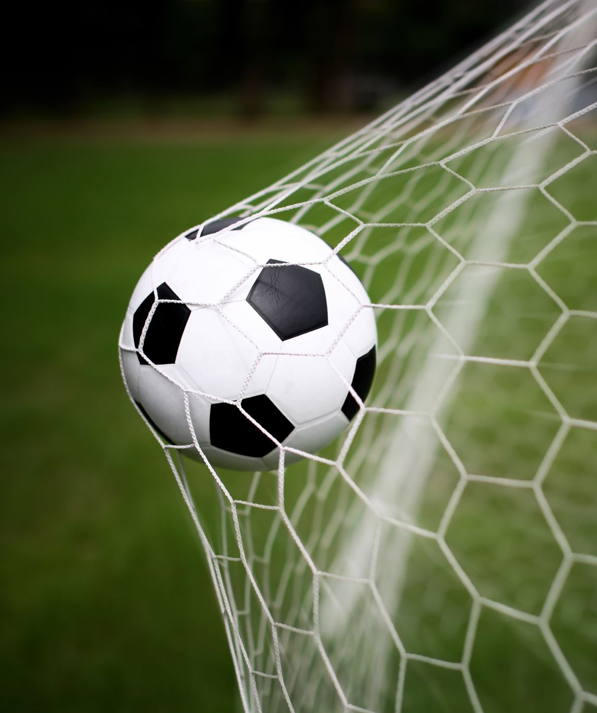
Goal
Diversify and grow funding to support the program
Strengthen volunteer base and leadership pipeline
Focus on student experience and well-being
Build Sustainability

Slide 3

Vision – Have a high parent and volunteer engagement, with robust funding through sponsorships and community involvement

Slide 4
AGENDA
Executive Board
Fundraising
Taste of the Eastern Shore
Treasurer’s Report
Committee Chairs

Slide 5
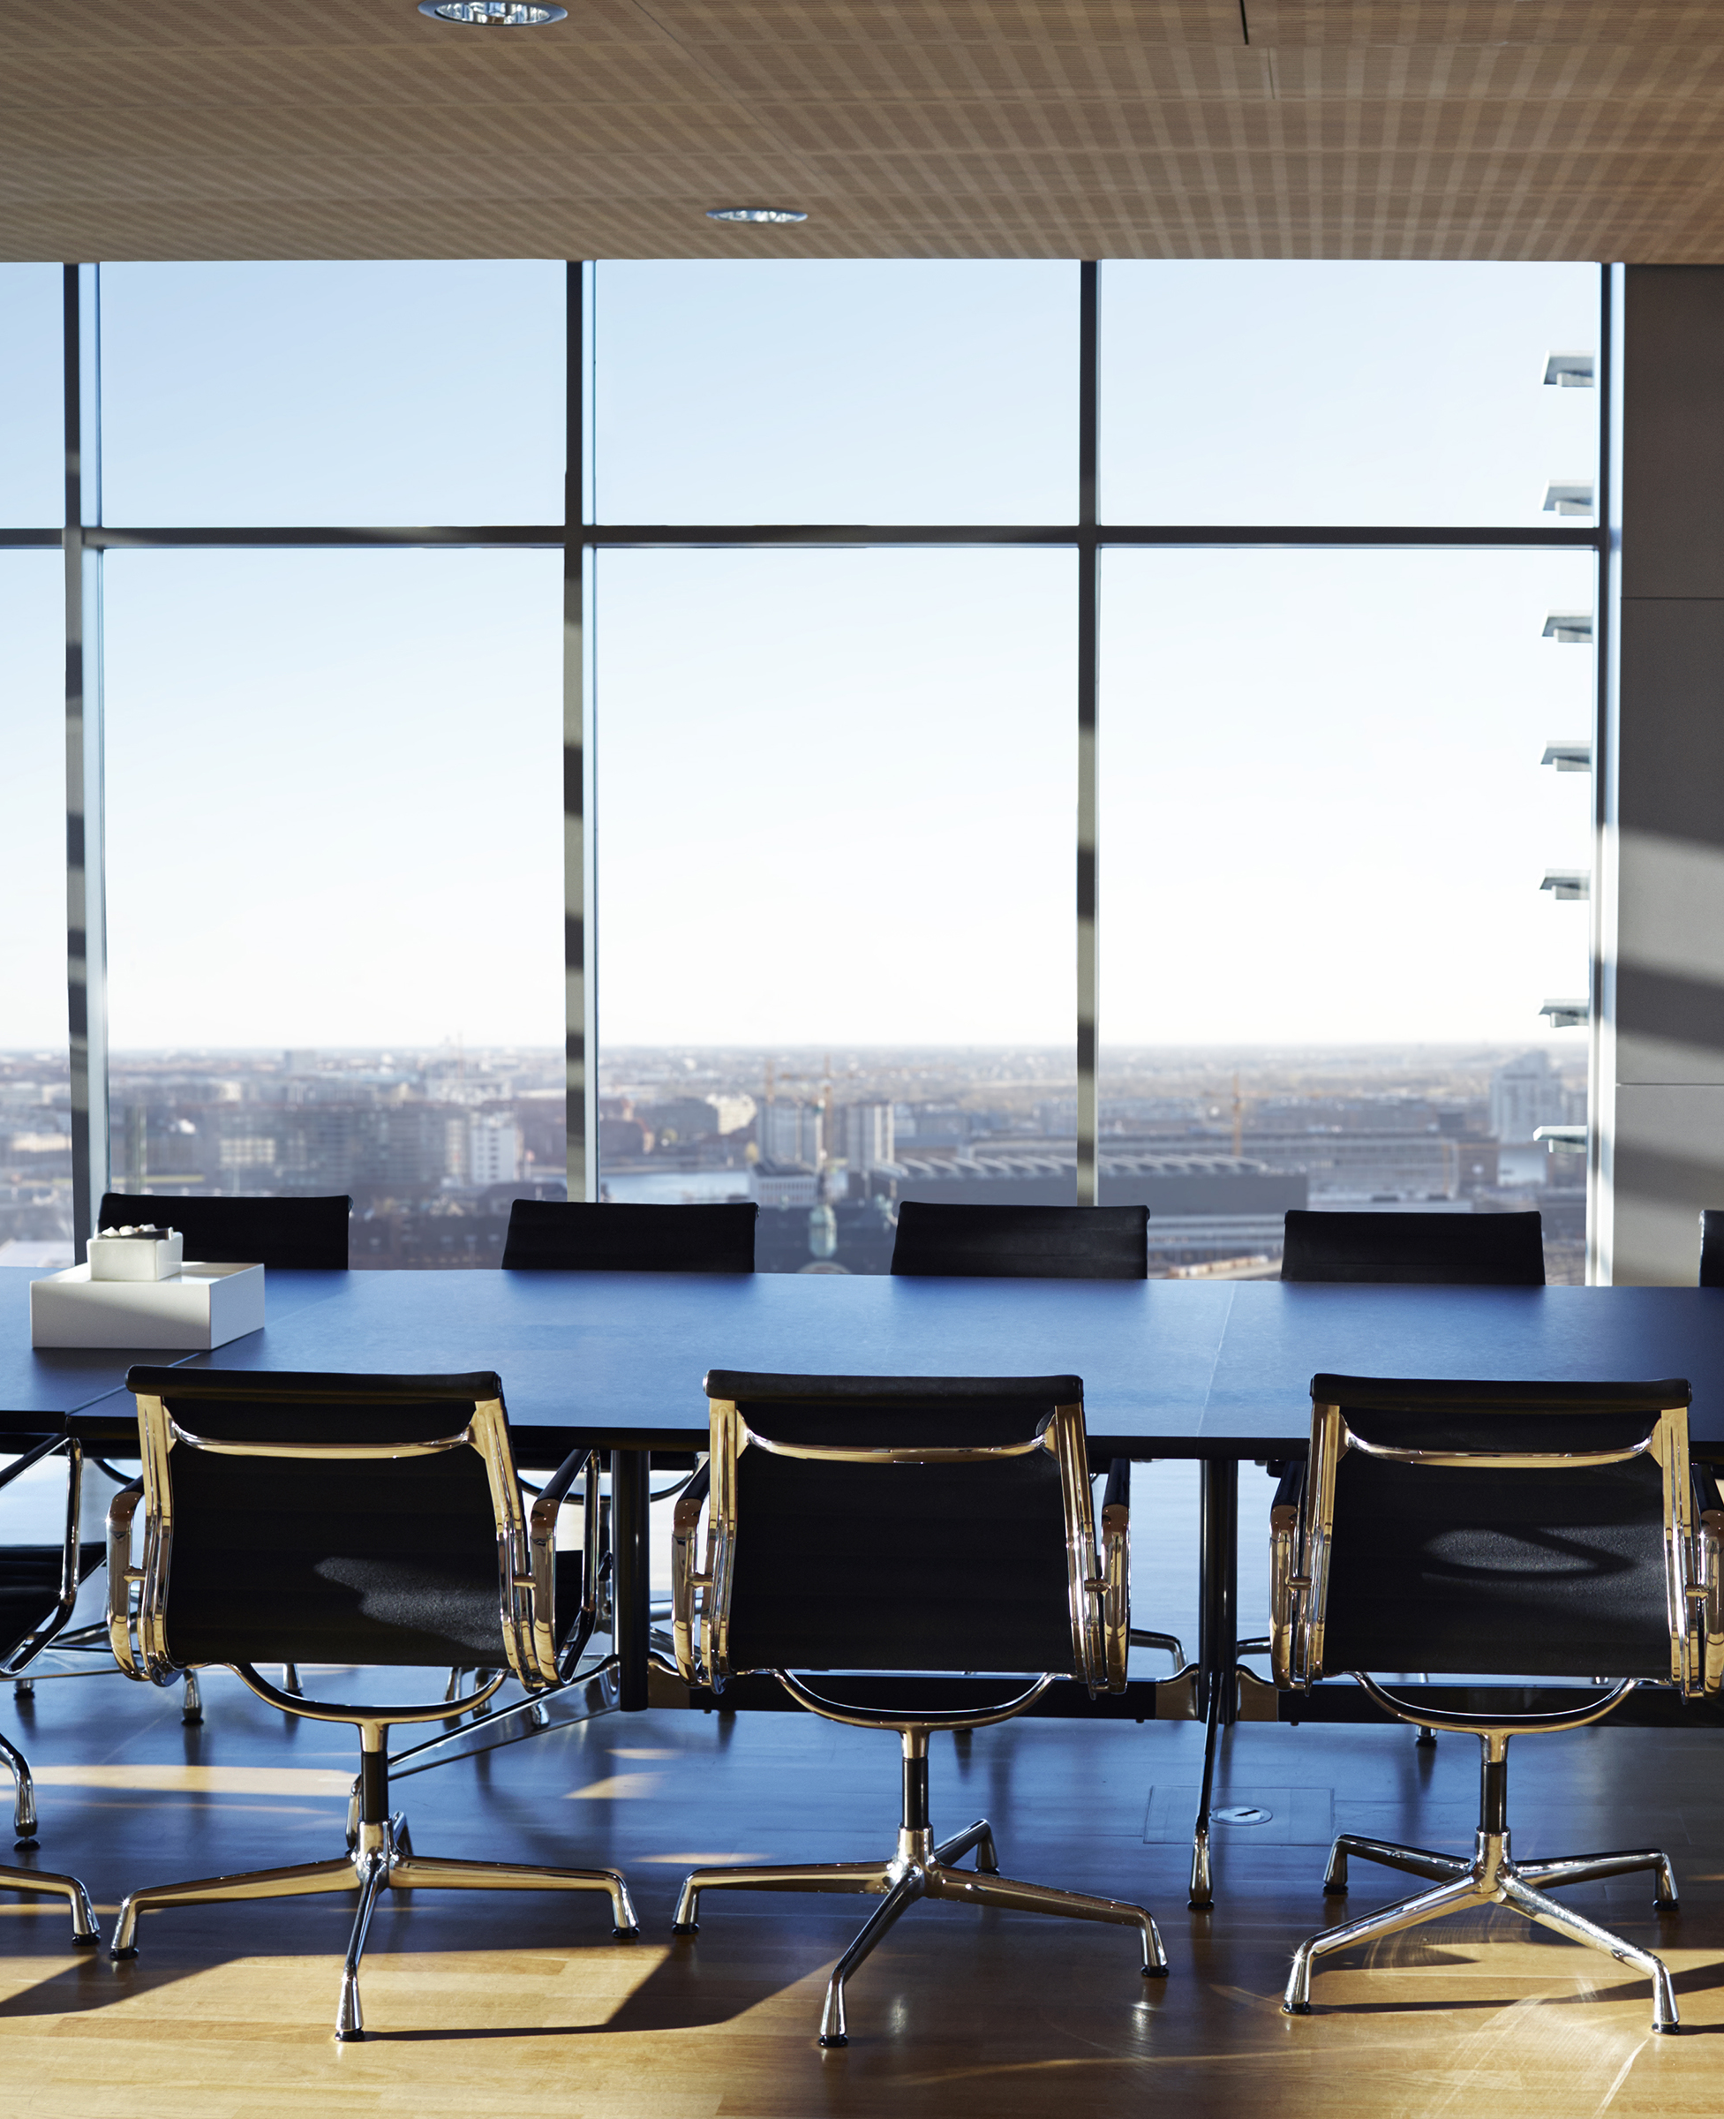
2026-2027 Executive Board
President – Phu Vuong
Vice President –
Treasurer – Heather Reese
Deputy Treasurer – Karen Moore
Secretary –

Slide 6
2026-2027 Executive Board Nominees
Vice President – Kyle Huxen
Secretary – Ali Robbins

Slide 7
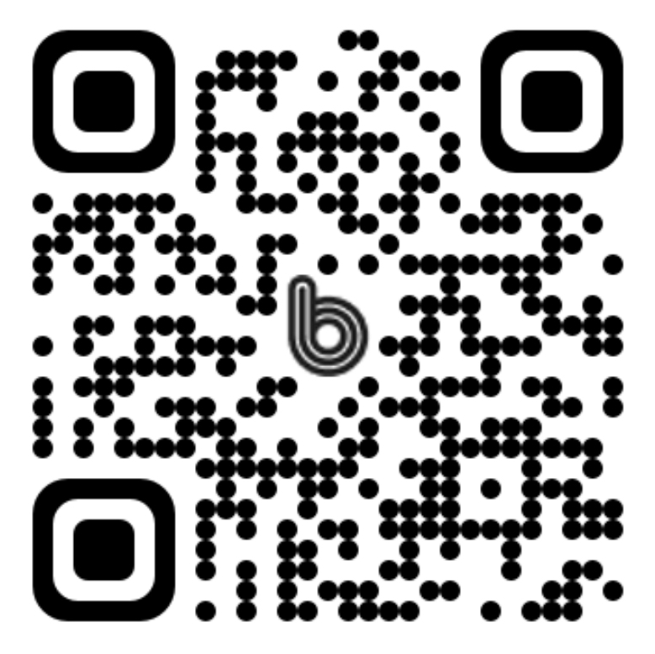
Join us on the Band App!

Slide 8
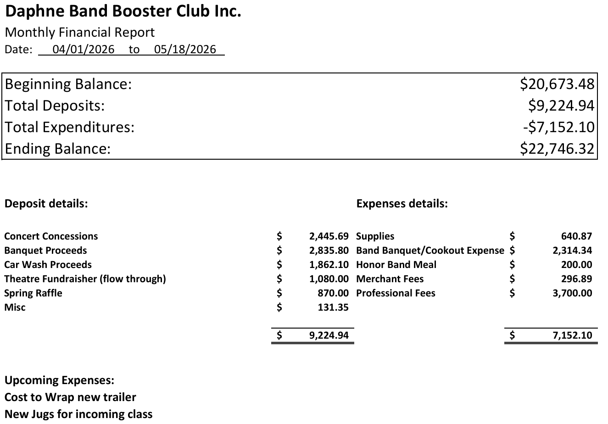
Treasurer’s Report
Karen Moore & Heather Reese

Slide 9
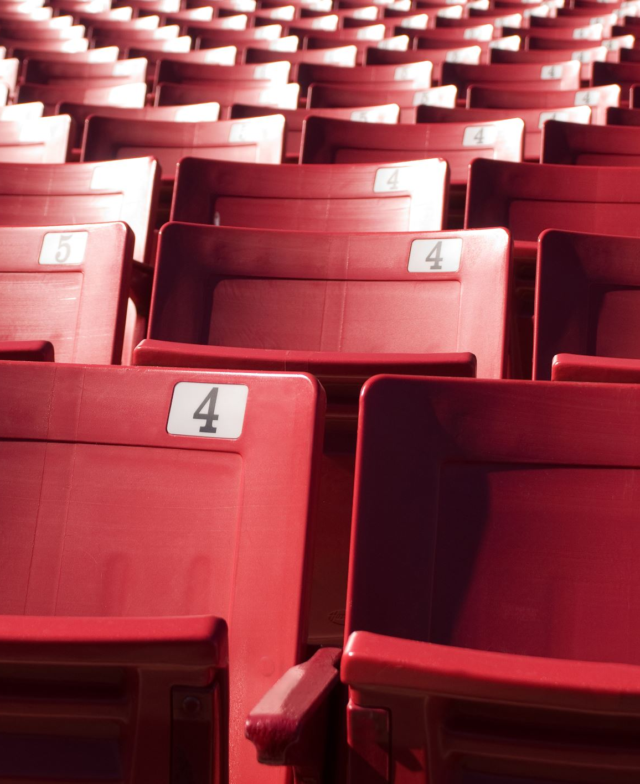
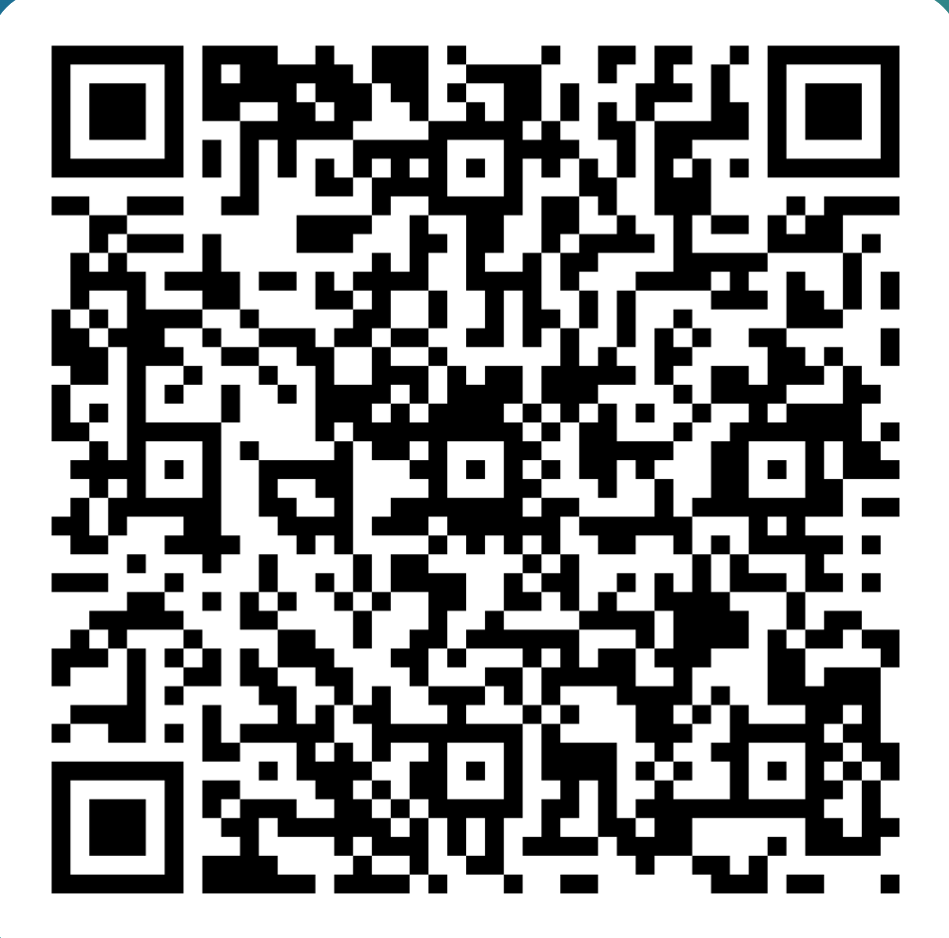
Chaperones
Chair:
Dana Furman
Complete your volunteer form!

Slide 10
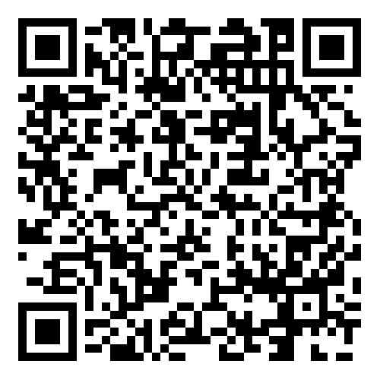
GET YOUR BIB CARD

Slide 11
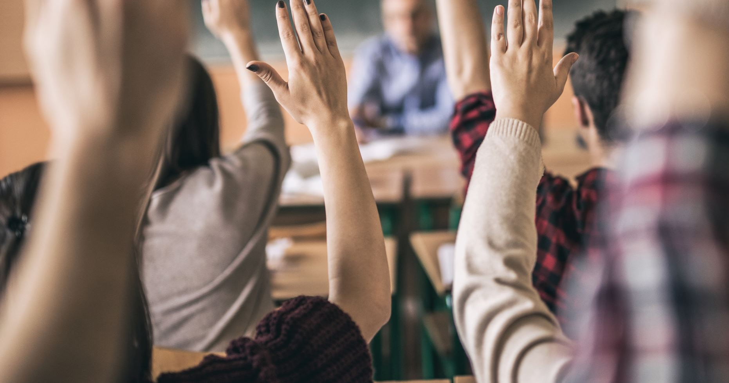
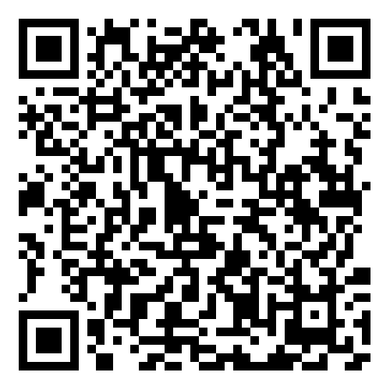
How Do You Volunteer?:
SignUp Genius

Slide 12
Why Your Help is Needed
Band Camp Pre-game meals
Taste of the Eastern Shore Pre-competition meals
Jamboree Fundraisers
Eastern Shore Classic Banquet
Concert Concessions Fittings

Slide 13
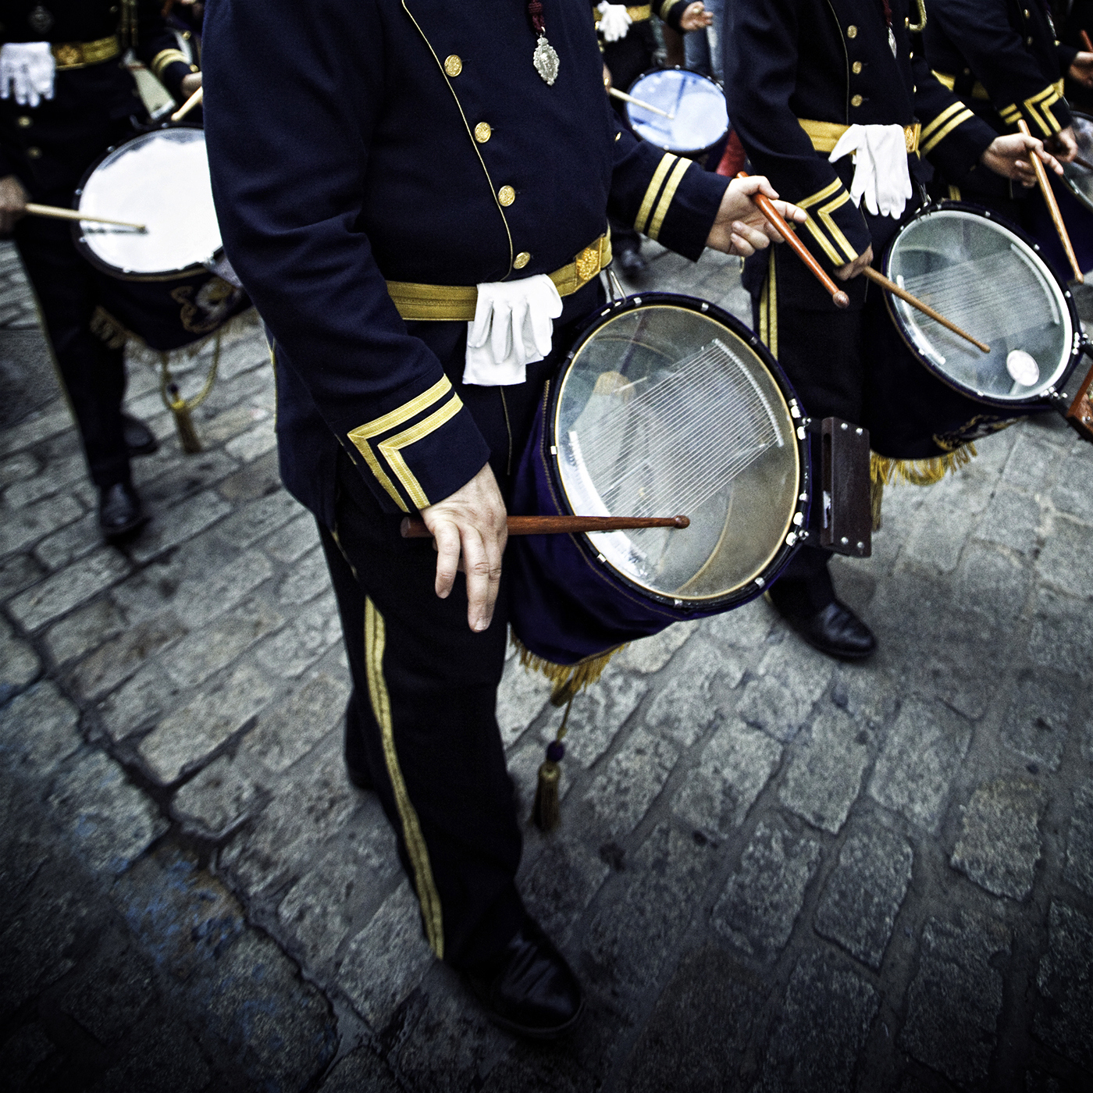
Uniforms
Chair:
Terrie Weinacker & Jennifer Jones
Amazon Registry!

Slide 14
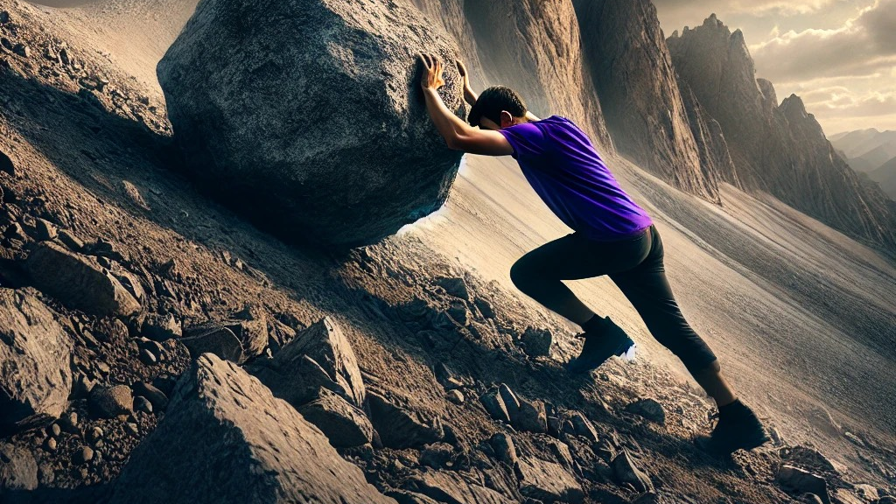
Equipment/Pit
Chair:
John Napiontek

Slide 15
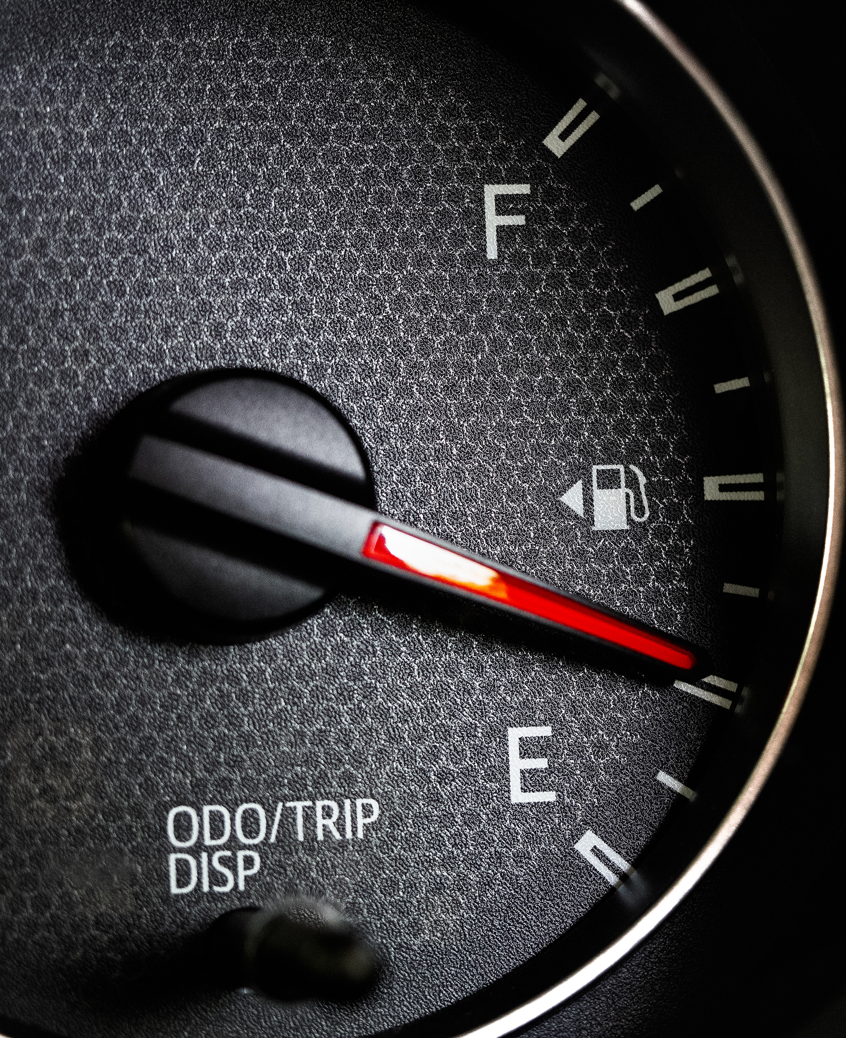
Vehicle/Motor Pool
Chair:
Josh Lepine

Slide 16

Parking Chair
*Responsible for securing parking volunteers for
events, such as all home games and the Eastern
Shore Classic.
*Arranging poles/ ropes/ barriers before home
games and taking them down afterwards.

Slide 17
Hospitality Chair
Responsible for planning, organizing, and implementing meals for band camp and pre-game football meals and all hosted competitions including Eastern Shore Classic Hospitality room

Slide 18
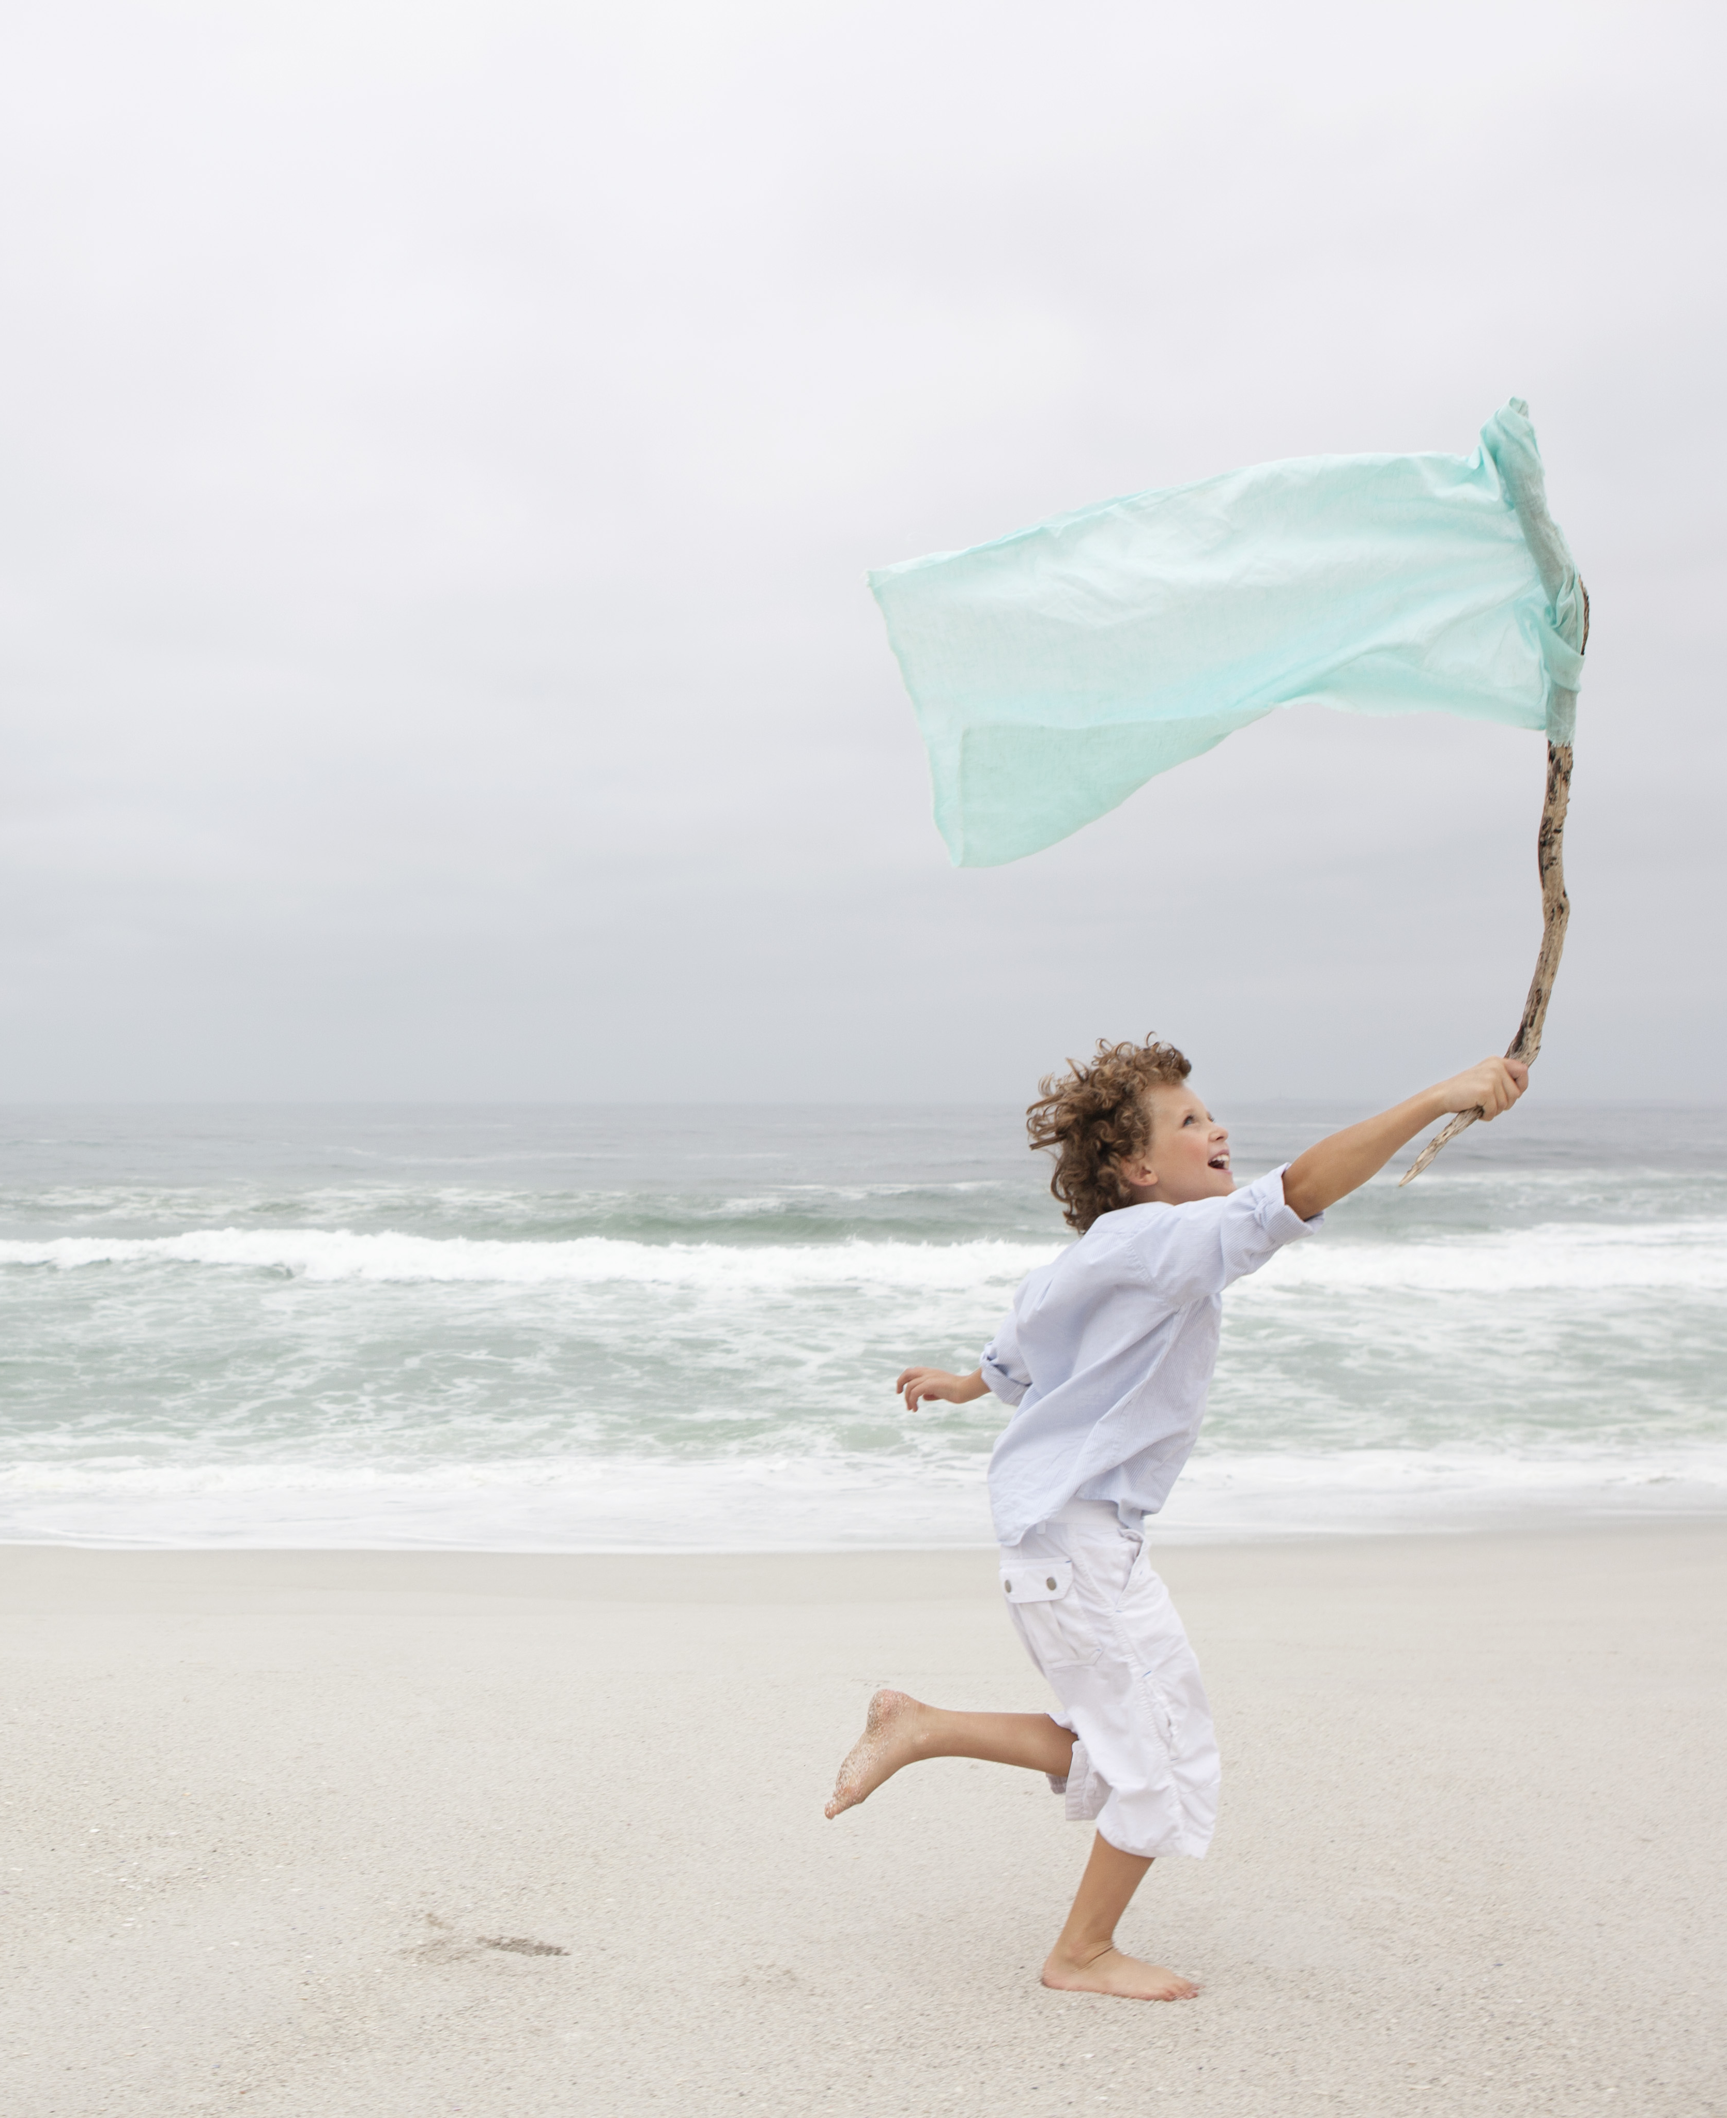
Auxiliary
Chair: Tracy Parckys

Slide 19
Fundraising

Slide 20
What do we raise funds for?
Meals – Band Camp, Pre-game, pre-competition, banquet etc.
Travel
Field Maintenance
Equipment Maintenance
Set-up money for fundraisers
Staff

Slide 21
Smoked Turkey Fundraiser
Some of our other fundraisers
Boston Butt Sale
Smoked Turkey Sale
Popcorn Sale
Car Wash
King Cake Sale
Concessions
Raffles

Slide 22
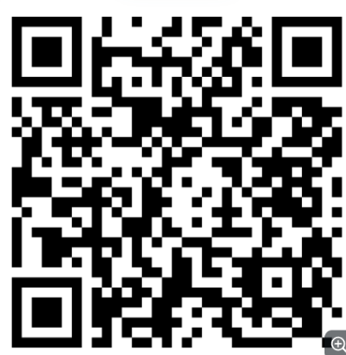
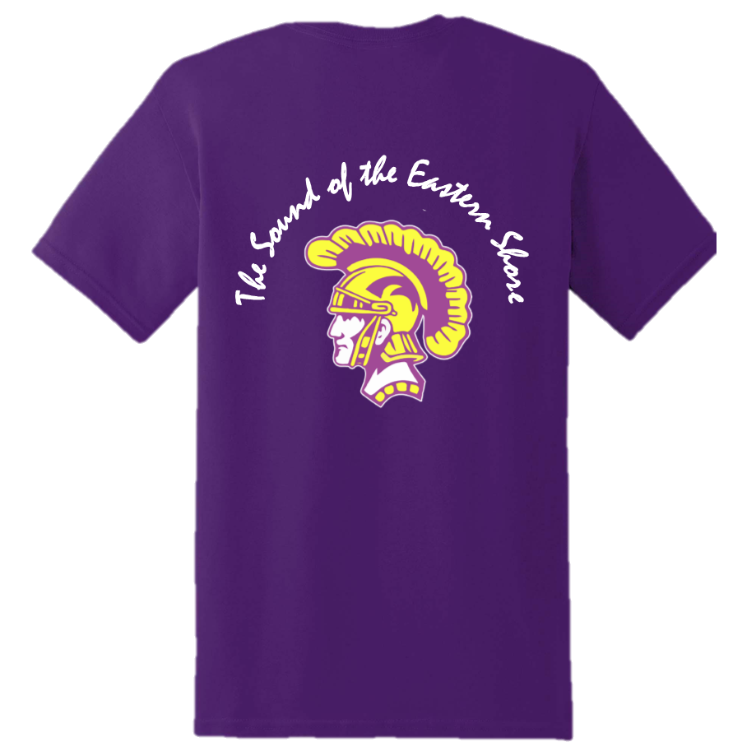
Band Booster
Store
Store Link

Slide 23
Questions
Next meeting – June 16th 6:00 PM
Band Room

